Slide 1
Introduction to Windows 7
Lesson 1

Slide 2
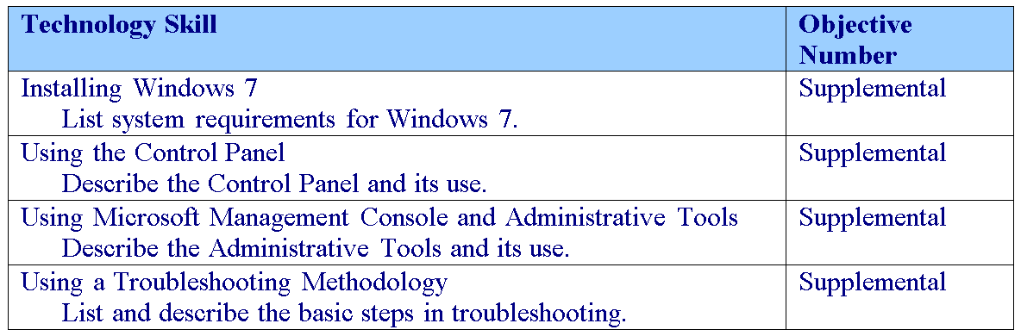
Objectives
Notes:
Outline the material you are going to cover in this lesson. Do not go into detail as each of these points will be expanded on in the lesson. You may also want to mention the Technology Skills that are being covered for the Certification exam.

Slide 3
Windows 7
Windows 7 is the newest version of Microsoft Windows operating system for desktop computers for use on personal computers, including home and business desktops, laptops, netbooks, tablet PCs, and media center PCs.
  Windows 7 will become the dominant operating system to replace Windows XP and Windows Vista.
Windows 7 was released to manufacturing on July 22, 2009, and reached general retail availability on October 22, 2009
  Windows 7 released less than three years after the release of its predecessor, Windows Vista.
Notes:
Windows 7 is based on Windows Vista and was designed to address those points for which Windows Vista was criticized.

Slide 4
Selecting Computer Hardware
The primary subsystems that make up a computer are:
  Processor
  Memory
  Storage
  Network
If any of these fails, the entire system can fail.
If any one of these is asked to do more than what it was designed for, it can cause a bottleneck that may affect the performance of the entire system.
Notes:
While this should be review for most of the students, hardware is a component that may fail that a Windows administrator may have to troubleshoot. In addition, as you review, explain how these components effect overall performance.

Slide 5
Processor
The computer is built around one or more integrated chips called the processor.
Today, the clock speed of the processor is usually expressed in gigahertz (GHz).
Most processors sold today are multicore processors that are like having two or more processing cores packaged as one.

Slide 6
Processor
For years, processors were 32-bit processors that could process up to 4 GB of memory.
A 64-bit processor is a processor with a default word size of 64 bits and a 64-bit external data bus.
Technically a 64-bit processor can access up to 16.3 billion gigabytes (16 exabytes).
  The AMD64 architecture currently has a 52-bit limit on physical memory (which supports up to 4 petabytes or 4048 terabytes) and only supports a 48-bit virtual address space (256 terabytes).
  Usually, you will reach the limit of the motherboard or memory chips before you reach the limit of the processor.

Slide 7
RAM
RAM (random access memory) is the computer’s short-term or temporary memory.
It stores instructions and data that the processor accesses directly.
In addition, having sufficient RAM can be the largest factor in your overall computer performance.
If power is discontinued from the RAM such as what occurs when you shut off your PC, the contents of the RAM disappear.

Slide 8
Hard Drives
Traditionally, hard drives are half electronic/half mechanical devices that store magnetic fields on rotating platters.
Today, some hard drives, known as solid-state drives, are electronic devices with no mechanical components.
  Mechanical devices have a higher failure rate than electronic devices.
Notes:
Emphasize that the mechanical devices are still reliable. But if you compare them, they fail more often than pure electronic devices.

Slide 9
Network Connections
The last primary component that makes up a computer is the network connection.
Without a network connection, the computer will not be able to communicate with other computers.
Most personal computers have network interface cards or NICs that allow them to communicate over corporate networks or to connect to the Internet via a cable or DSL modem.

Slide 10
Motherboard
Another component that brings these four subsystems together is the motherboard.
For the processor to communicate with the rest of the system, it plugs in or connects to a large circuit board called the motherboard or system board.
The motherboard allows the processor to branch out and communicate with all of the other computer components.

Slide 11
System ROM BIOS
Instructions that control much of the computer’s input/output functions, such as communicating with disks, RAM, and the monitor kept in the System ROM chips are known as the BIOS (basic input/output system).
By having instructions (software) written on the BIOS, the system already knows how to communicate with some basic components such as a keyboard and how to read some basic disks such as IDE drives.

Slide 12
System ROM BIOS
BIOS may need to have a bug fixed or may need to be expanded to support a new type of hardware that did not exist when the BIOS was written.
To overcome some problems, you would have to check with your system or motherboard manufacturer to see if they have a new version of the BIOS that you can download and apply to your system.
The process of updating your system ROM BIOS is called flashing the BIOS.
Notes:
Explain the general process of flashing the BIOS.

Slide 13
Power Supplies and Cases
A case provides an enclosure that helps protect the components that are inside of the case.
  The case with the power supplies and additional fans are usually designed to provide a fair amount of airflow through the system to keep the system cool.
Power supply converts AC into clean DC.
  Power supplies are electronic

Slide 14
Ports
Ports are plug sockets that enable an external device such as a printer, keyboard, mouse, or external drive.
  Parallel port
  Serial port
  Universal serial bus (USB)
  PS/2 Mouse or keyboard port
  RJ-45 connector

Slide 15
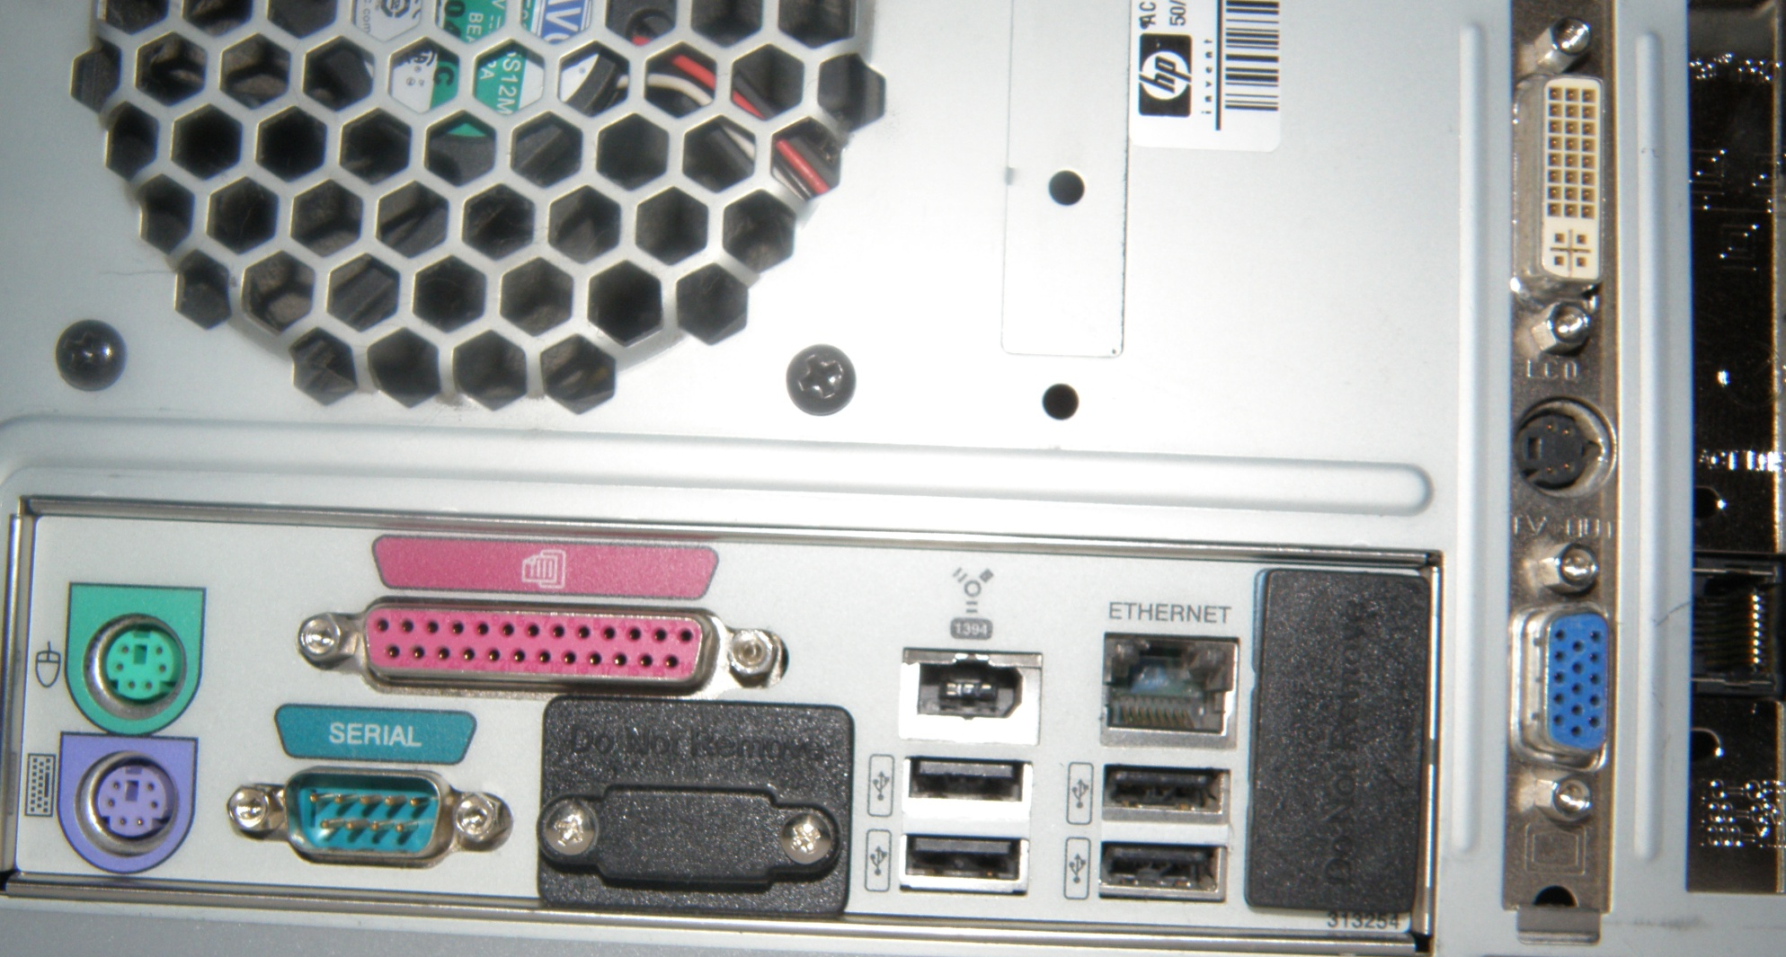
Ports

Slide 16
Video Systems
The video system consists of video cards/adapters and the monitor.
Some systems require high-performance video cards for graphical demanding purposes such as PC games and video editing.
Ports:
  VGA (Video Graphics Array)
  DVI (Digital Visual Interface)
  VIVO (Video In Video Out)
  HDMI (High Definition Multimedia Interface)

Slide 17
Sound System
A sound card or audio card is a computer expansion card that facilitates the input and output of audio signals to and from a computer used with multimedia applications such as music composition, editing video or audio, presentation, education, and entertainment (games).
Many computers have sound capabilities built in, while others require additional expansion cards to provide for audio capability.

Slide 18
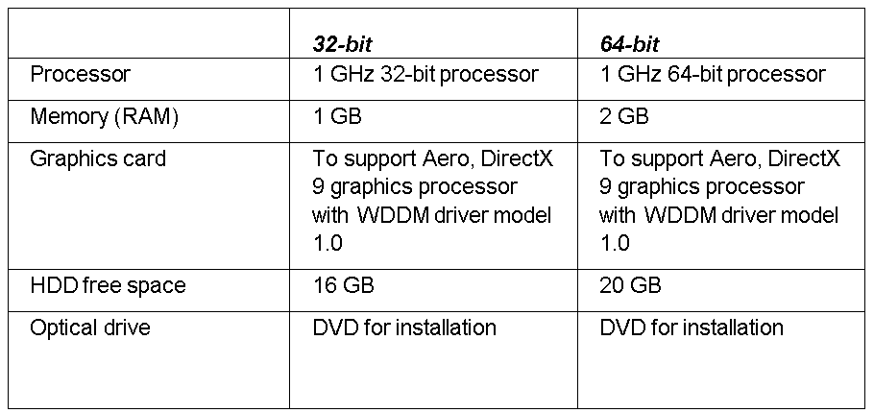
Windows 7 System Requirements
Notes:
Again emphasize that these are minimum. At least double is recommended for fair performance.

Slide 19
Windows 7 System Requirements
For most 32-bit version of Windows 7, Windows can recognize up to 4 GB of memory:
  Except for the Windows 7 Starter edition, which only recognizes 2 GB of memory.
For the 64-bit version of Windows 7, Windows 7 Ultimate, Enterprise, and Professional can recognize up to 192 GB.
Windows 7 Home Premium 64-bit recognizes up to 16 GB and Windows 7 Home Basic 64-bit recognizes up to 8 GB of memory.

Slide 20
Windows 7 System Requirements
To minimize problems, you should only choose hardware that is on the Hardware Compatibility List (HCL) for Windows 7 because new hardware models and devices are being created every day.

Slide 21
Clean Installation
A clean installation is installing the software from scratch on a new drive or on a newly reformatted drive.
Many people find that doing a clean install of an operating system is the best way to go because it offers a fresh start.
The disadvantage is that the system and all of its software needs to be reinstalled, patched and configured, and data copied over, something that may take hours.

Slide 22
Upgrade
In some instances, you may want to take a current system and upgrade from Windows Vista to Windows 7 using the upgrade installation.
Unfortunately, you cannot perform an in-place upgrade from 32-bit to 64-bit architecture and from one language to another.

Slide 23
Upgrade
You can perform an in-place upgrade from a lower edition of Windows 7 to a higher one using the Windows Anytime Upgrade tool.
It should also be noted that you cannot directly upgrade from Windows XP to Windows 7.
  You cannot upgrade directly from Windows XP to Windows 7. Instead, you will first have to upgrade to Windows Vista, then upgrade Windows Vista to Windows 7.

Slide 24
Control Panel
As with previous versions of Windows, the main graphical utility used to configure the Windows environment and hardware devices is the Control Panel.

Slide 25
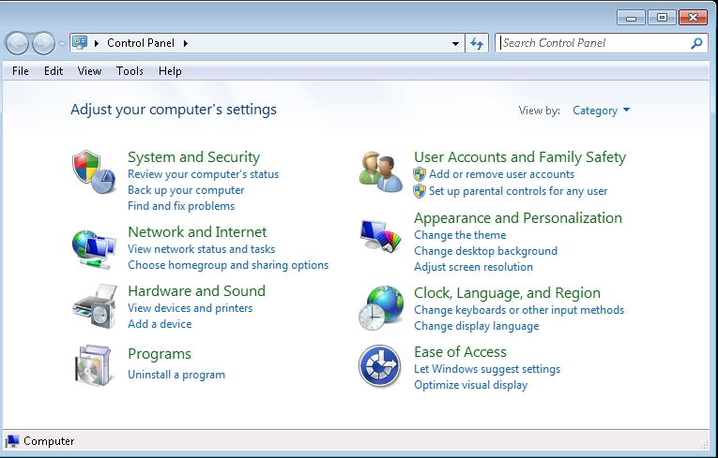
Control Panel

Slide 26
User Account Control
User Account Control (UAC) is a feature that started with Windows Vista and is included with Windows 7 that helps prevent unauthorized changes to your computer.
If you are logged in as an administrator, UAC asks you for permission, and if you are logged in as a standard user, UAC will ask you for an administrator password before performing actions that could potentially affect your computer’s operation or that change settings that affect other users.
Notes:
Since the UAC is designed to make sure that unauthorized changes are not made, especially by malicious software that you may not know you are running, you need to read the warnings carefully, and then make sure the name of the action or program that’s about to start is one that you intended to start.

Slide 27
User Account Control
As a standard user, in Windows 7, you can do the following without administrative permissions or rights:
  Install updates from Windows Update.
  Install drivers from Windows Update or those that are included with the operating system.
  View Windows settings.
  Pair Bluetooth devices with the computer.
  Reset the network adapter and perform other network diagnostic and repair tasks.

Slide 28
System Settings
One of the most important configuration settings for a Windows administrator is the System settings within the Control Panel.
This includes gathering generation information about your system, changing the computer name, adding the computer to a domain, accessing the device manager, configuring remote settings, configuring startup and recovery options, and configuring overall performance settings.

Slide 29
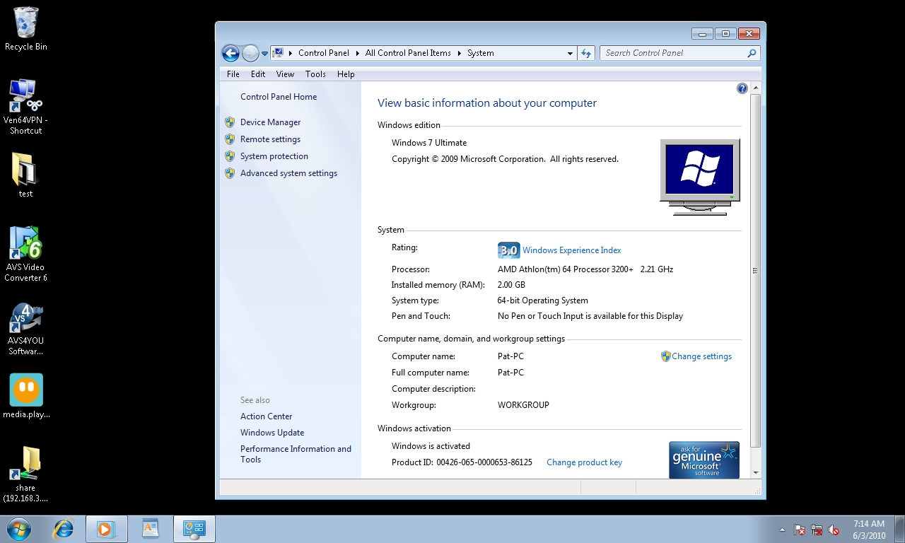
System Settings

Slide 30
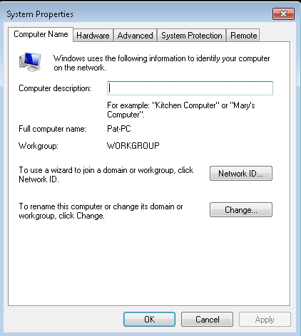
System Settings

Slide 31
Action Center
Action Center is a central place to view alerts and take actions that can help keep Windows running smoothly.
Action Center lists important messages about security and maintenance settings that need your attention.
Red items in Action Center are labeled Important, and indicate significant issues that should be addressed soon, such as an outdated anti-virus program that needs updating.

Slide 32
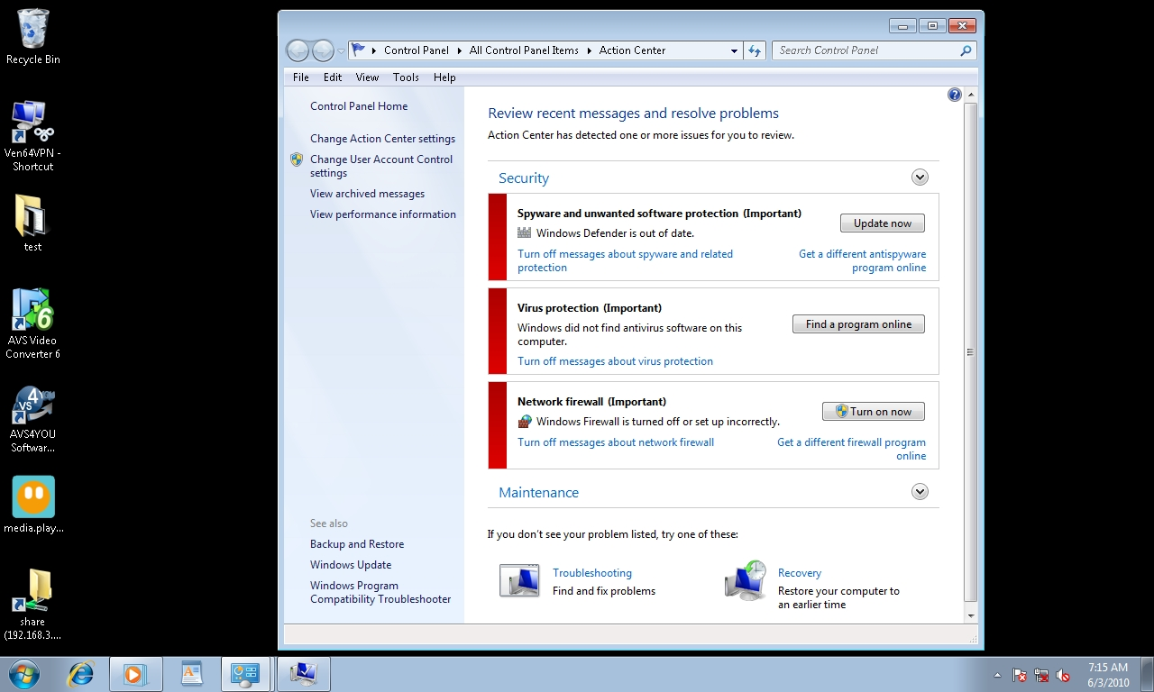
Action Center

Slide 33
Reliability Monitor
To get to the Reliability Monitor, you just need to open the Action Center. Then under the Maintenance section, click View reliability history. You can then:
  Click any event on the graph to view its details.
  Click Days or Weeks to view the stability index over a specific period of time.
  (1 – least stable 2 – most stable)
  Click items in the Action column to view more information about each event.
  Click View all problem reports to view only the problems that have occurred on your computer.

Slide 34
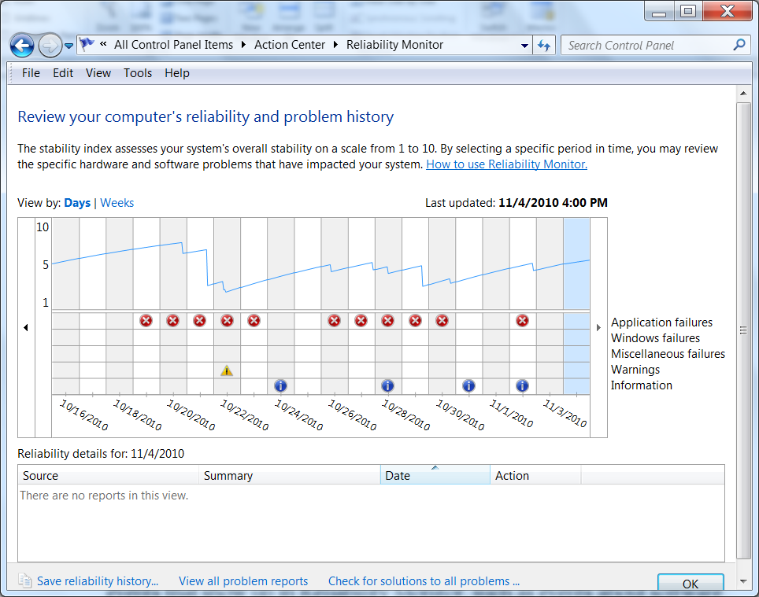
Reliability Monitor

Slide 35
Troubleshooting Using the Control Panel
The Control Panel contains several troubleshooting programs that can automatically fix some common problems with your computer, such as problems with networking, hardware, or devices, using the web, and program compatibility.

Slide 36
Microsoft Management Console (MMC)
The Microsoft Management Console (MMC) is one of the primary administrative tools used to manage Windows and many of the network services provided by Windows.
It provides a standard method to create, save, and open the various administrative tools provided by Windows.
When you open Administrative Tools, most of these programs are available for MMC.

Slide 37
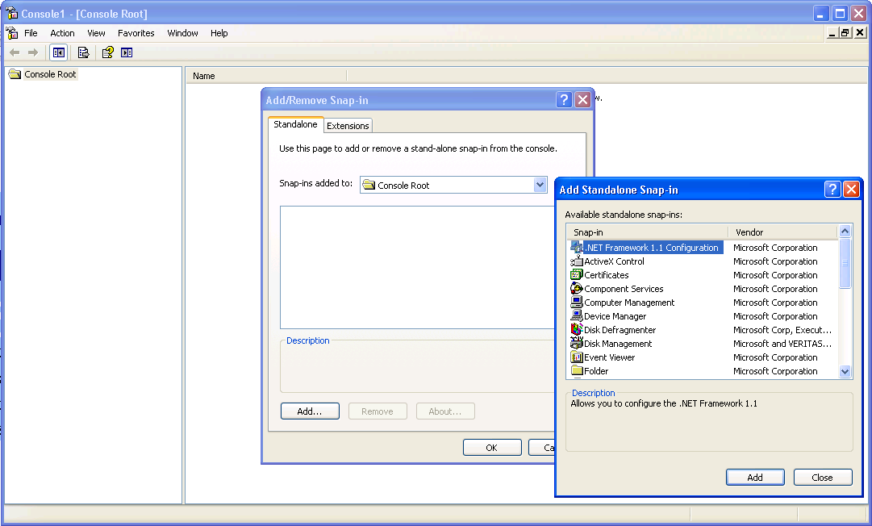
Microsoft Management Console (MMC)

Slide 38
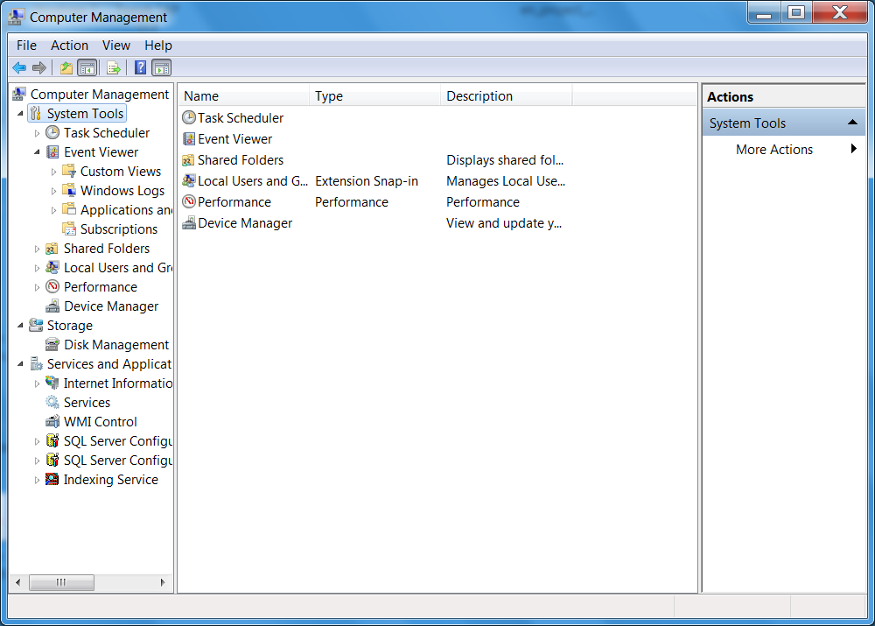
Computer Management Console

Slide 39
Services
A service is a program, routine, or process that performs a specific system function to support other programs or to provide a network service.
It runs in the system background without a user interface.

Slide 40
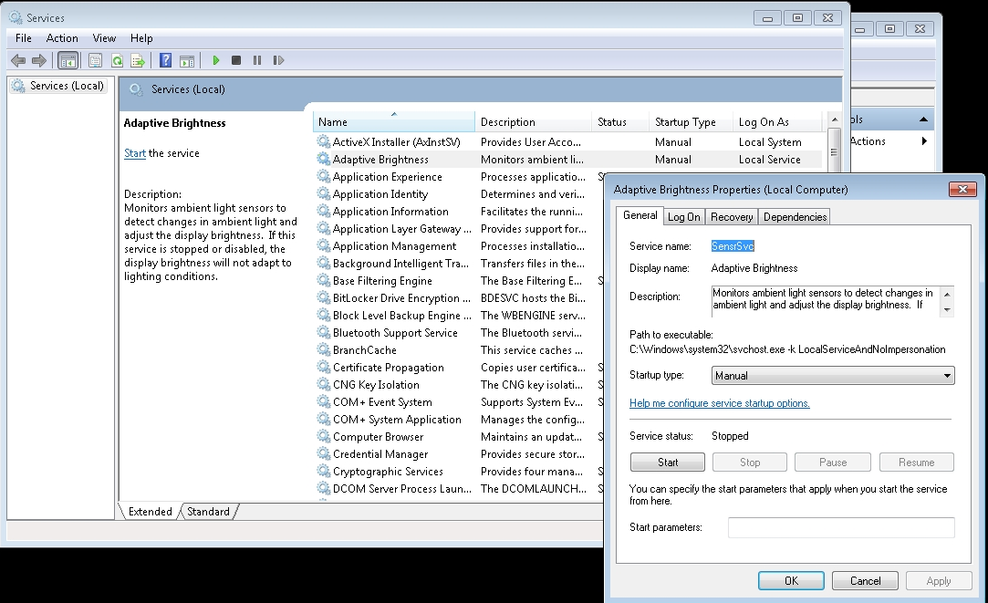
Services

Slide 41
Registry
The registry is a central, secure database in which Windows stores all hardware configuration information, software configuration information, and system security policies.
Components that use the registry include the Windows kernel, device drivers, setup programs, hardware profiles, and user profiles.

Slide 42
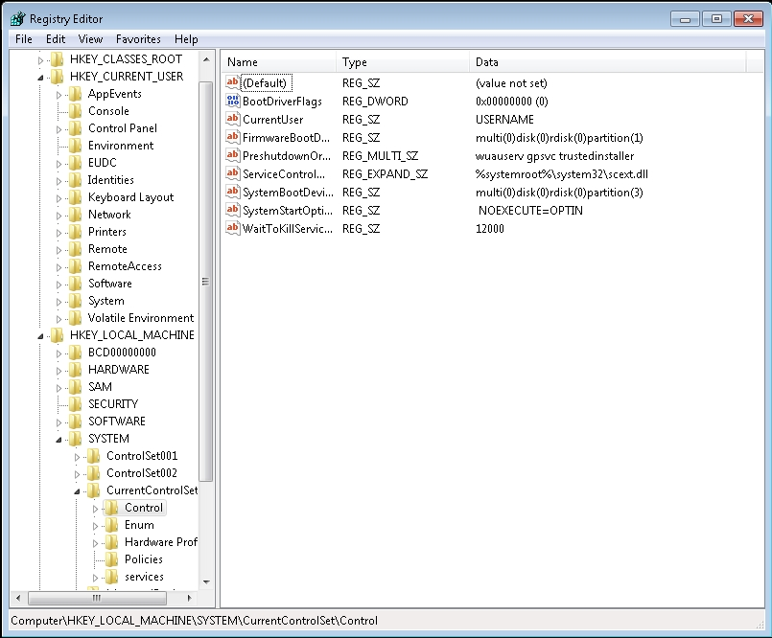
Registry Editor

Slide 43
Troubleshooting Methodology
The whole purpose of effective troubleshooting methodologies is to reduce the amount of guesswork and random solutions so that you can troubleshoot and fix the problem in a timely methodical manner.

Slide 44
Troubleshooting Methodology
Discover the problem.
Evaluate system configuration.
List or track possible solutions, and try to isolate the problem by removing or disabling hardware or software components.
Execute a plan.
Check results.
Take a proactive approach.

Slide 45
Troubleshooting Tools
System Information
Device Manager
Event Viewer
Task Manager
Resource Monitor
Performance Monitor
Boot Menu including Safe mode
Windows Repair
System Configuration
Memory Diagnostics tool
Troubleshooting Wizard

Slide 46
System Information
When you first start troubleshooting a computer, you need to know what is in the computer and what is running on the computer.
  Looked at System properties for the processor and amount of RAM. Looked at Device Manager to see what hardware is recognized and what drivers are loaded.
  The System Information program is a useful troubleshooting tool that you can use to see inside a system.

Slide 47
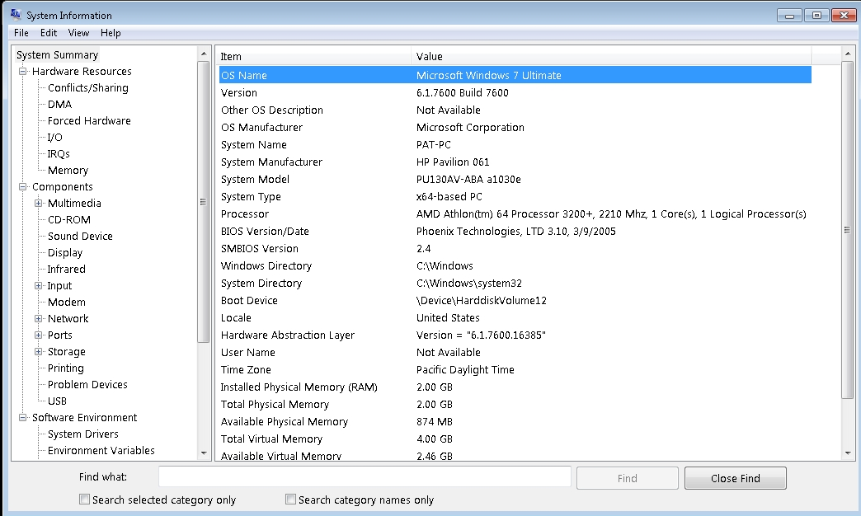
System Information

Slide 48
Event Viewer
The Event Viewer is a Microsoft Management Console (MMC) snap-in that enables you to browse and manage event logs.
It is included in the Computer Management console and is included in Administrative Tools as a stand-alone console.
You can also execute the eventvwr.msc command.

Slide 49
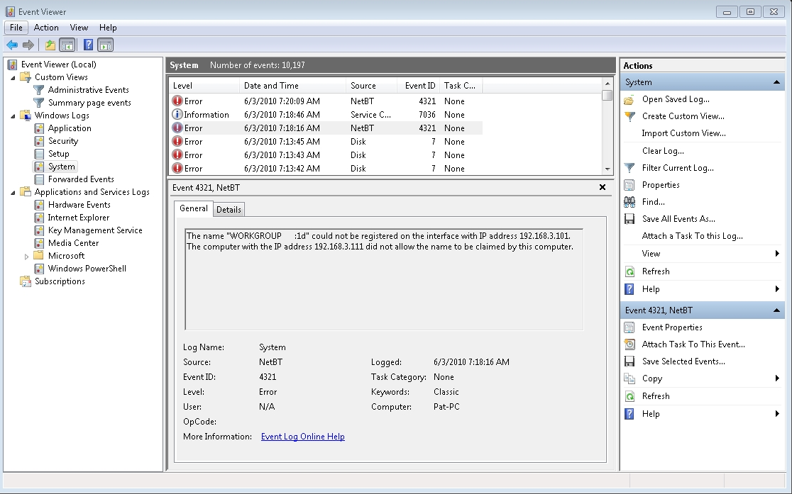
Event Viewer

Slide 50
Skill Summary
While installing Windows 7, keep in mind the system requirements to properly run Windows 7 and its applications.
To minimize problems, you should only choose hardware that is on the Hardware Compatibility List (HCL) for Windows 7.
As with previous versions of Windows, the main graphical utility to configure the Windows environment and hardware devices is the Control Panel.
Notes:
Review the Skill Summary to wrap up your lesson.

Slide 51
Skill Summary
One of the most important configuration settings for a Windows administrator is the System settings within the Control Panel. This includes gathering generation information about your system, changing the computer name, adding the computer to a domain, accessing the device manager, configuring remote settings, configuring startup and recovery options, and configuring overall performance settings.

Slide 52
Skill Summary
Action Center is a central place to view alerts and take actions that can help keep Windows running smoothly.
Troubleshooting in the Control Panel contains several programs that can automatically fix some common problems with your computer, such as issues with networking, hardware, and devices, using the web, and program compatibility.

Slide 53
Skill Summary
The Microsoft Management Console (MMC) is one of the primary administrative tools used to manage Windows and many of the network services provided by Windows.
Administrative Tools is a folder in the Control Panel that contains tools for system administrators and advanced users.
The Computer Management Console is one of the primary tools to manage a computer running Windows 7 and includes the most commonly used MMC snap-ins.

Slide 54
Skill Summary
A service is a program, routine, or process that performs a specific system function to support other programs or to provide a network service.
The registry is a central, secure database in which Windows stores all hardware configuration information, software configuration information, and system security policies.

Slide 55
Skill Summary
Following a troubleshooting methodology to efficiently troubleshoot a problem will help you solve many problems.
One of the most useful troubleshooting tools is the Event Viewer MMC snap-in, which essentially is a log viewer.

